Slide 1

LevelUp: Skill-Based Community App
Your personal growth companion for learning new skills, tracking progress, and connecting with like-minded learners. Available as both web and mobile applications.

Slide 2

Why LevelUp?
Growth Made Fun
Never Feel Stuck
Community Support
Transform learning into an interactive, achievable experience through gamification and social engagement.
AI-powered personalized challenges keep you motivated and progressing at your own pace.
Connect with motivated learners, share wins, and learn from others in skill-based communities.

Slide 3



Key Features
Skill Communities
AI-Powered Quests
Clans & Gamification
Join communities for programming, design, fitness, languages, and more. Share tips and celebrate achievements together.
Personalized challenges created by AI based on your skill level to ensure continuous growth.
Create or join clans, complete quests together, earn rewards, and compete on leaderboards.

Slide 4

Technical Architecture
Frontend
Backend
Web: Responsive design for desktops and tablets
Node.js with Express framework
Mobile: React Native app for iOS and Android
Prisma ORM with PostgreSQL database
Multi-language support (8+ languages)

Slide 5
Current Learning Landscape
Digital learning has exploded with specialized apps for different skills:
Fitness
Languages
Home Workout apps for physical training
Duolingo for language practice
Coding
Academics
Scrimba for programming skills
Coursera and Khan Academy for courses
The Problem: Fragmentation across multiple apps with separate logins, interfaces, and progress tracking.

Slide 6
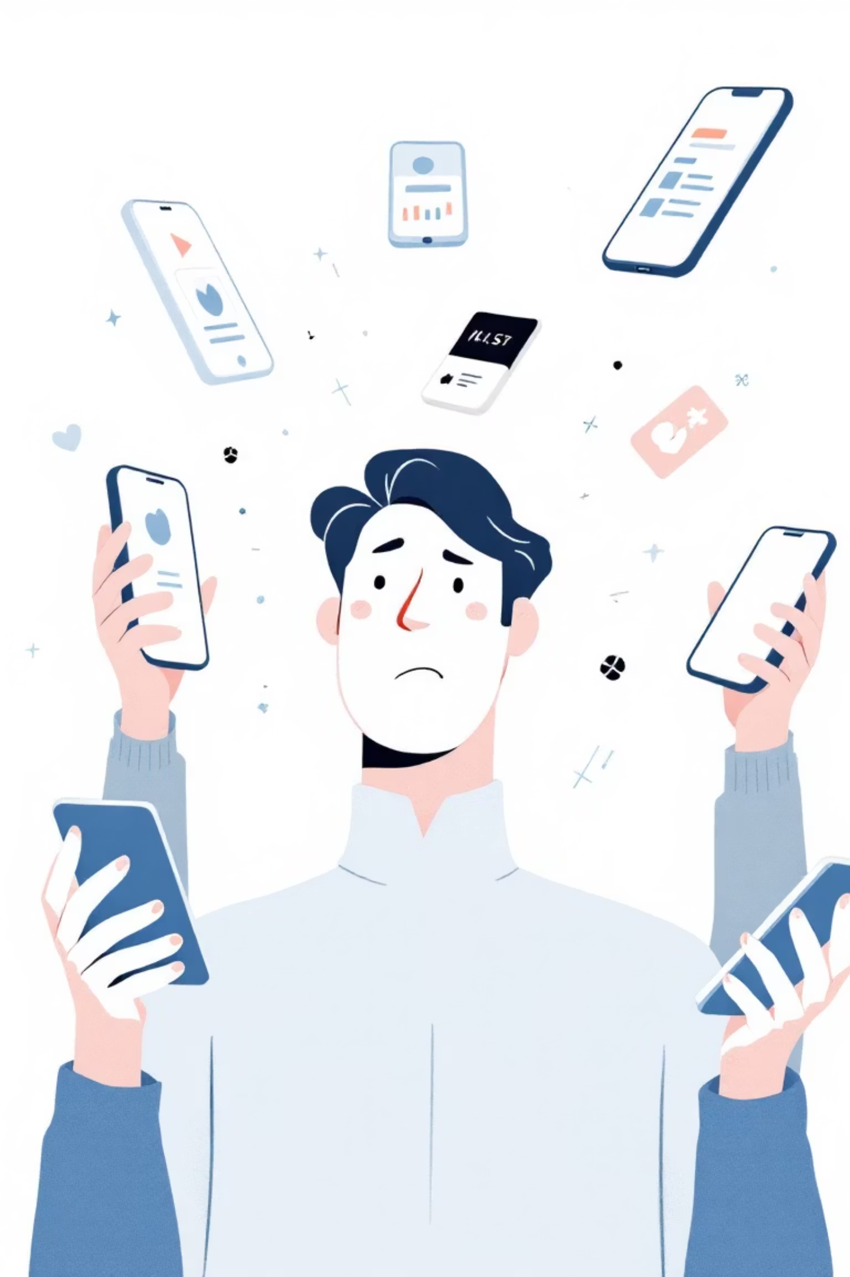
The Fragmentation Challenge
Learners wanting to develop coding skills, practice languages, and stay fit must switch between multiple apps, creating fatigue and reducing motivation.
Each platform operates independently, making it difficult to maintain consistent learning habits across different skill areas.

Slide 7
Problem Statement
Lack of Motivation
Fragmented Community
Learners struggle without interactive content, instant feedback, or rewards for consistent progress.
Limited collaboration and peer support due to lack of unified platform for connection and progress tracking.
Isolation in Learning
Limited Personalization
Skill development feels lonely without teamwork, competition, and group challenges.
Content doesn't adapt to individual levels or goals, reducing engagement and challenge.

Slide 8




LevelUp's Solution
Multi-Skill Coverage
Explore fitness, technology, creative arts, and personal finance in one platform.
Community-First Learning
Interest-based groups, challenges, and live discussions keep users connected.
Unified Progress Tracking
Single dashboard tracks progress across all skills, eliminating app switching.
Gamified Experience
AI-driven challenges, points, badges, and leaderboards make learning fun and personalized.

Slide 9



Project Objectives
Community-First Platform
Build a learning environment that encourages collaboration, progress sharing, and teamwork among students and professionals.
Engaging & Personalized
Create an interactive learning experience using AI-driven challenges, rewards, and gamified elements tailored to individual needs.

